Slide 1


ONLINE EXAMINATION SYSTEM
Under the Guidance of
Mr. Satyam Mishra
Trainer(KSS Pvt. Ltd.)
Submitted To: Mr. Satyam Singh AP CSE Dept.
Submitted By: Jyoti Yadav (2101440109004)

Slide 2
Outline
Introduction
Importance And Need
Advantage And Disadvantage
Tools And Technology
Data Flow Diagram
Result
Conclusion
Future Scope
References

Slide 3
Introduction
The Online Examination System is an electronic application. It is an on-line test simulator is to take online examination, test in an efficient manner and no time wasting for manually checking of the test paper.
The main objective of this web based online examination system is to efficiently evaluate the student thoroughly through a fully automated system that not only saves lot of time but also gives fast and accurate results.
For students they give papers according to their convenience from any location by using internet and time and there is no need of using extra thing like paper, pen etc

Slide 4
Importance and Need
Online examination system uses fewer resources and reduce the need for question papers and answer scripts, exam room scheduling, arranging invigilators, coordinating with examiners, and more.
Online Examination System is a computerized system that gives instant results and also saves time.
Through Remote Proctoring Multiple numbers of candidates can complete their examination at the same time and there is no requirement for physical faculty for monitoring due to the use of remote proctoring.

Slide 5
Advantage
Environmentally friendly
Saves you money
Saves time, big time
Plugged into technology
More secure, less cheating
Disadvantage
Infrastructure problems
Challenges of tech

Slide 6
Tools And Technology
Tools:
SQL Server Management Studio 2008(Database Server)
Windows 8 or above(OS)
IIS Server(Web server)
Google Chrome(Web browser),
ASP .NET Web Application(.NET Framework)
IDE – Visual Studio of Microsoft .

Slide 7
Technology
Front-end:
Designing – HTML, CSS, Bootstrap & Media Query
Client-Side Programming language – Java Script, jQuery
Back-end :
Database – MSSQL
Programming Language – .NET With MVC- C#

Slide 8
Data Flow Diagram
User
Online
Examination
Student
Admin

Slide 9
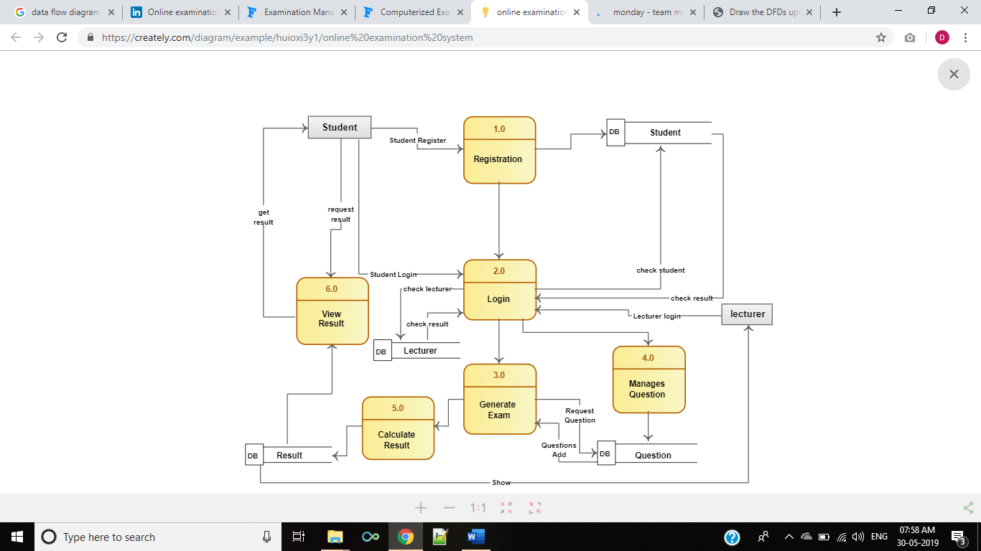
E – R Diagram

Slide 10
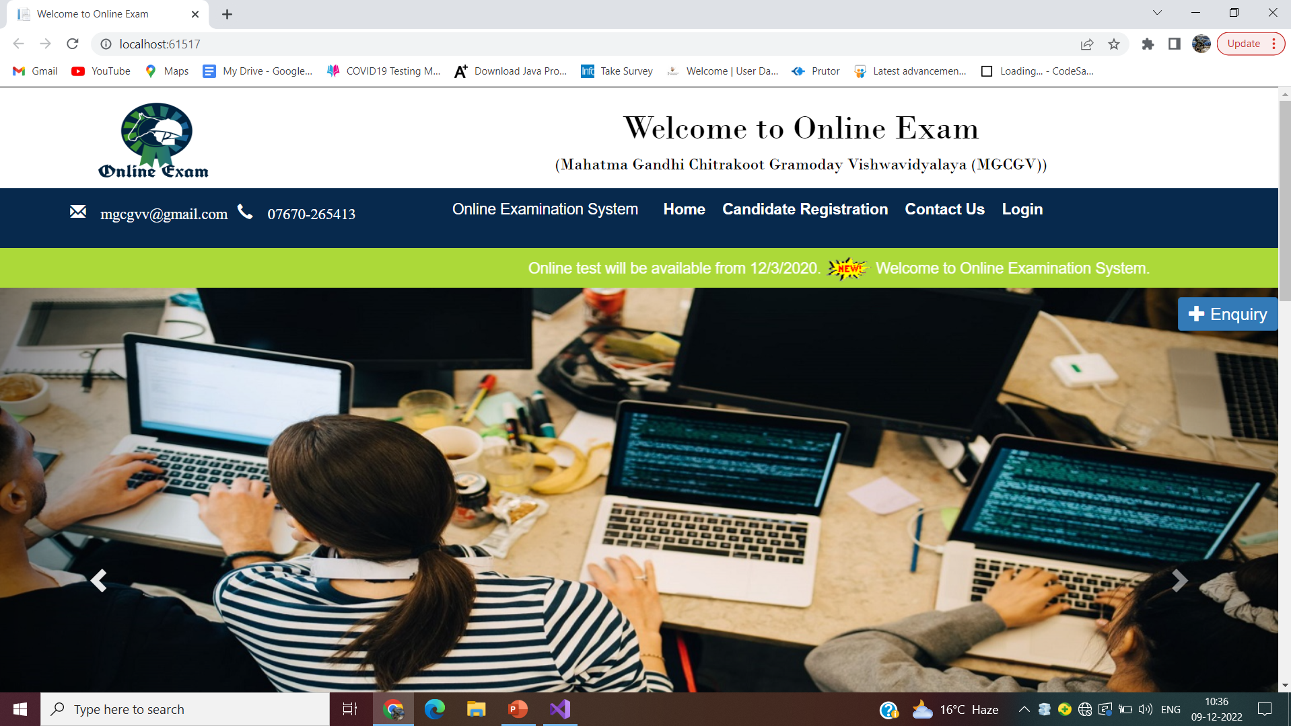
Result This slide is tell about home view of project here header , menu, label slider and enquiry also include.

Slide 11
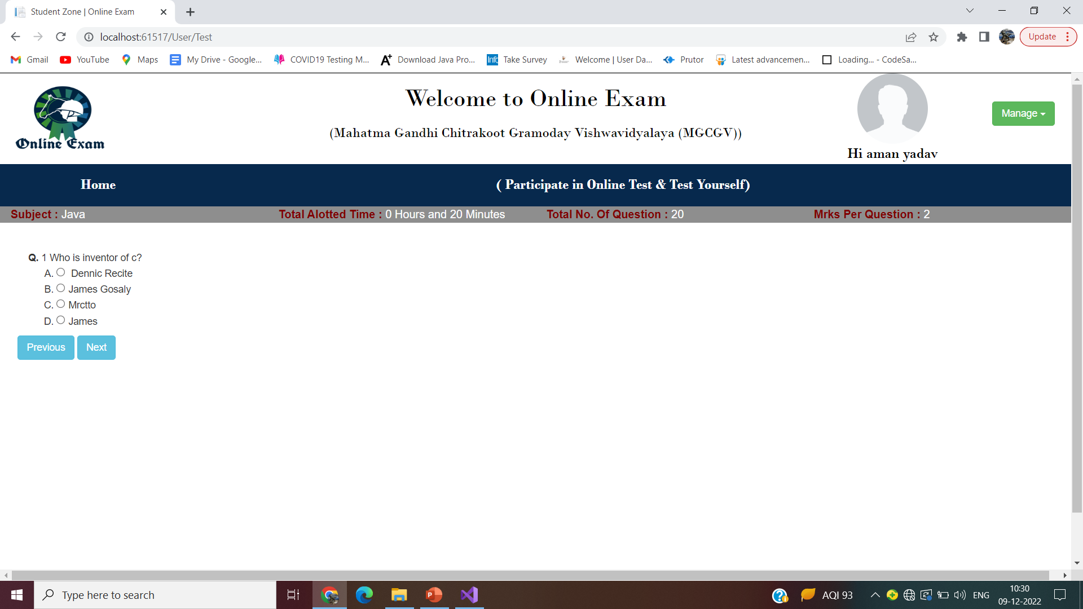
This slide is tell about examination window and view, here user name , photo , number of question ,time and change password also includes.

Slide 12
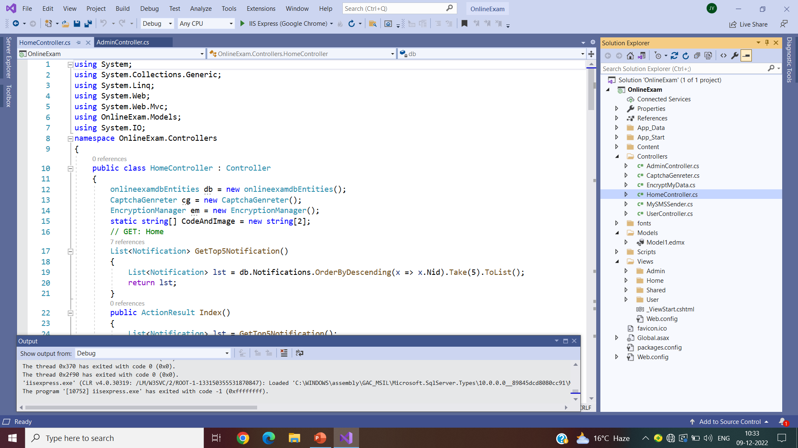
Coding This image is tell about home page code and all files folder like view model and controller.

Slide 13
Conclusion
Online examination system is a user friendly system, which is very easy and convenient to use. The system is complete in the sense that it is operational and it is tested by entering data and getting the reports in proper order. But there is always a scope for improvement and enhancement. During the development of this ,coding standards are followed for easy maintainability and extensibility.

Slide 14
Future Scope
To modify the Online Examination System project to .Net platform to take the advantage of geographical remote area. By shifting the project to the Dot Net platform the project can be made into a Mobile Accessible Application by which the restrictions of the software & hardware requirements can be scaled down, which is not possible using ASP.
We can even use the thumb mark of the users to confirm their identities .
We can even add the photos of the users in this to confirm the user Identity.

Slide 15
References
http://www.scribd.com/doc/33852099/on-line-examiniation-system-project-report .
https://beginnersbook.com/java-tutorial-for-beginners-with-examples/
https://www.google.com.
https://www.w3schools.com

